Slide 1
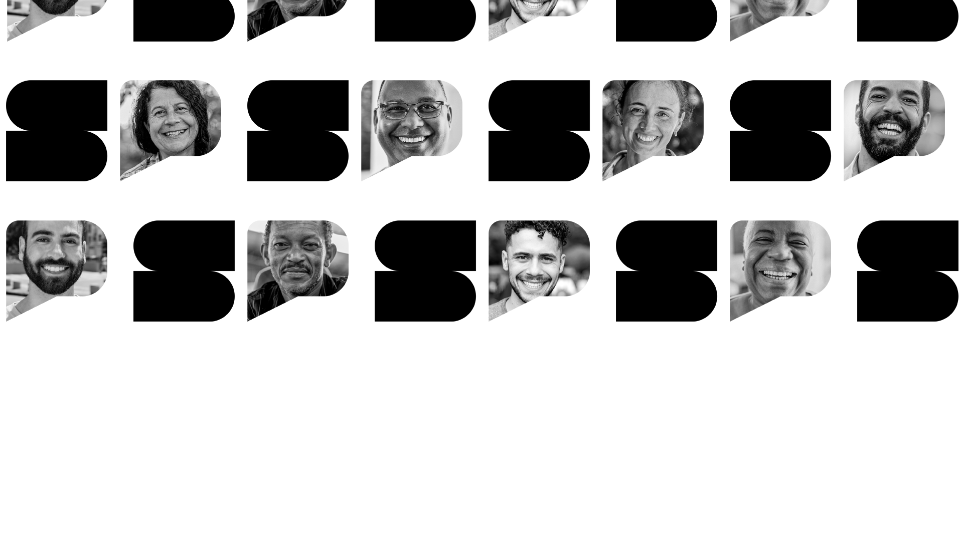




SafeView: Blind Spot Reduction System for Large Vehicles
19/11/2025

Slide 2
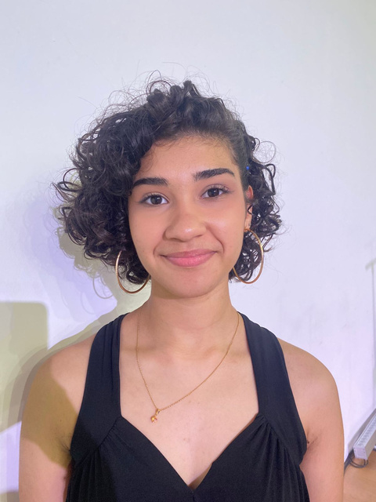
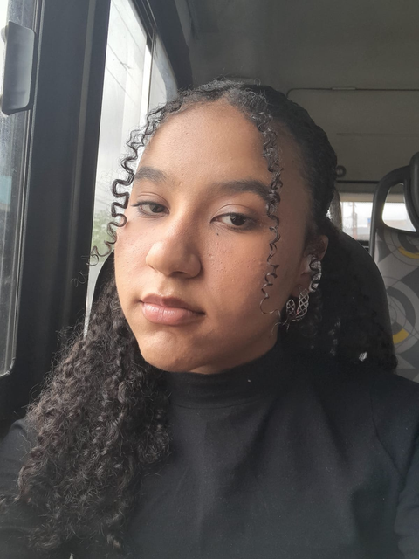
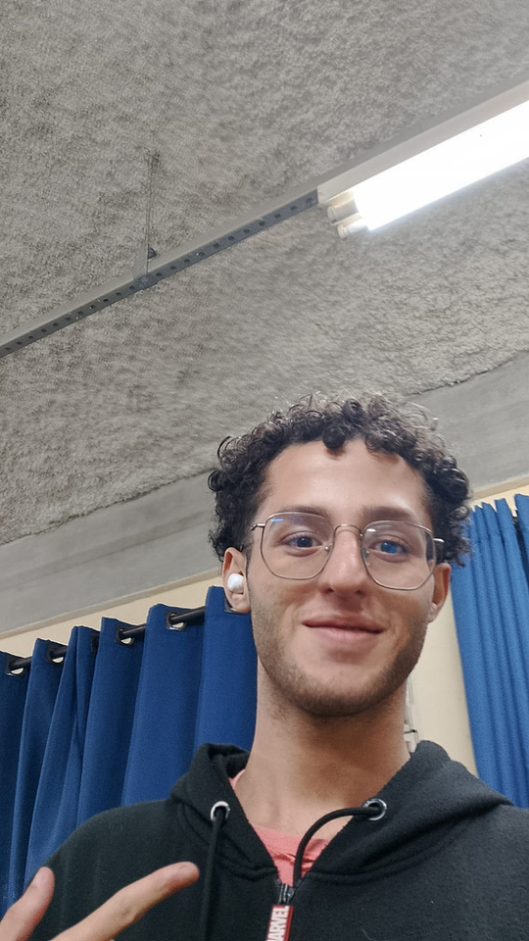
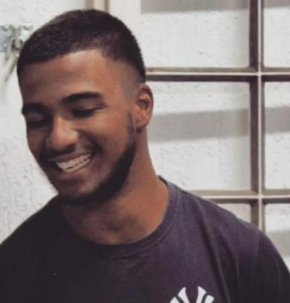
GROUP MEMBERS
ESTER RODRIGUES SOARES
GABRIELLY NASCIMENTO BENTO
GUSTAVO HENRIQUE RIBEIRO DA SILVA
JHONATA ALVES DO NASCIMENTO

Slide 3

OUR THEME
WHY A BLIND SPOT REDUCTION SYSTEM?
Trucks pose serious risks on the road due to limited visibility of pedestrians, cyclists, and smaller vehicles.
This work aims to provide solutions that enhance safety and reduce accidents caused by blind spots.
Notes:
O objetivo da SafeView é reduzir pontos cegos e tornar o trânsito mais seguro para motoristas e todos ao seu redor.
A nossa proposta é criar um sistema IoT de monitoramento com sensores e câmeras que detectam veículos, pedestres e ciclistas nos pontos cegos, enviando alertas visuais em tempo real para o motorista.
Diferente de sistemas caros e complexos, a SafeView é pensada para caminhões menores, com instalação rápida, uso simples e integração prática, sem grandes dificuldades técnicas.

Slide 4
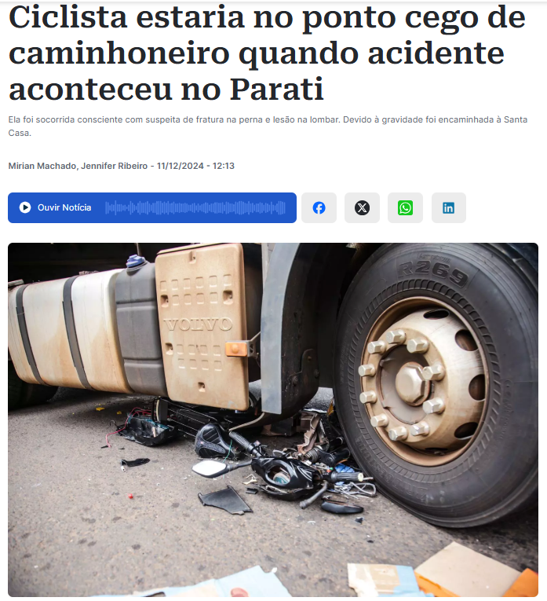

JUSTIFICATION
Blind spot risk: large vehicles remain dangerous in urban traffic.
Serious impact: over 3,000 pedestrian and cyclist deaths between 2013–2023; 312 in 2024 in Brazil alone.
Tech limitations: cameras and sensors still uncommon, especially in older trucks and small transport companies.
Source: midiamax, 2024.

Slide 5

TARGET AUDIENCE
Truck drivers spending long hours on the road. They are also constantly exposed to the unavoidable blind spots of large vehicles.
Notes:
O objetivo da SafeView é reduzir pontos cegos e tornar o trânsito mais seguro para motoristas e todos ao seu redor.
A nossa proposta é criar um sistema IoT de monitoramento com sensores e câmeras que detectam veículos, pedestres e ciclistas nos pontos cegos, enviando alertas visuais em tempo real para o motorista.
Diferente de sistemas caros e complexos, a SafeView é pensada para caminhões menores, com instalação rápida, uso simples e integração prática, sem grandes dificuldades técnicas.

Slide 6
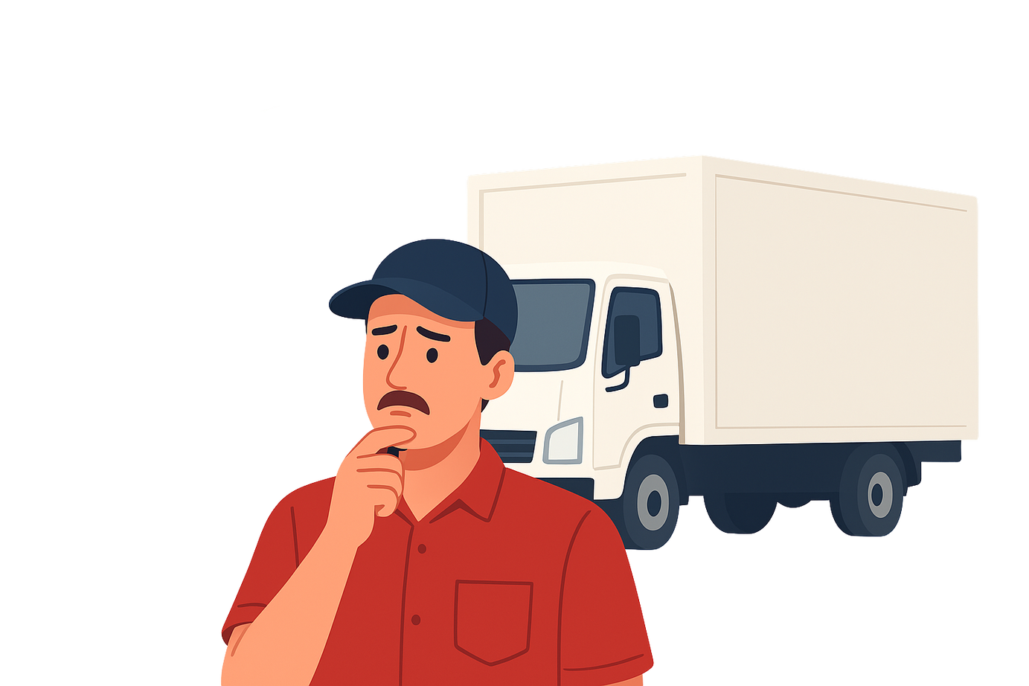

PROBLEMATIC
High costs: Expensive tools deter investment due to financial risks.
Financial risk: Uncertainty about returns leads truckers to avoid technology.
Tech distrust: Less tech-savvy truckers fear difficulties with digital solutions.

Slide 7

OBJECTIVES
General objectives: Develop an IoT system with an efficient app to support blind spot monitoring in box trucks and improve road safety.
Specific objectives:
Implement a monitoring system with sensors and cameras.
Ensure compatibility with different truck models.
Guarantee easy installation and operation.
Notes:
O objetivo da SafeView é reduzir pontos cegos e tornar o trânsito mais seguro para motoristas e todos ao seu redor.
A nossa proposta é criar um sistema IoT de monitoramento com sensores e câmeras que detectam veículos, pedestres e ciclistas nos pontos cegos, enviando alertas visuais em tempo real para o motorista.
Diferente de sistemas caros e complexos, a SafeView é pensada para caminhões menores, com instalação rápida, uso simples e integração prática, sem grandes dificuldades técnicas.

Slide 8



METHODOLOGY
QUALITATIVE METHODOLOGY:
Qualitative changes do not come from quantitative ones, but replace them. (MARCONI and LAKATOS, 2017).
less quantity more quality
Based on box truck accidents and visual impairments.
Notes:
A direção do projeto se consolida com uma metodologia qualitativa, já que as pesquisas e estudos existentes não oferecem números estatísticos especifícos, conforme mencionado anteriormente.
No entanto, esse materiais destacam fatores que explicam as tragédias no trânsito.
Nosso estudo se baseia em relatos de acidentes envolvendo caminhões baú e limitações visuais dos motoristas.
---------------------------------
The project's direction is consolidated with a qualitative methodology, since existing research and studies do not offer specific statistics,
as previously mentioned.
However, these materials will highlight factors that explain traffic tragedies.
Our study is based on reports of accidents involving box trucks and drivers' visual impairments.

Slide 9


CONCEPTUAL FOUNDATIONS
Figure 1 - CET
In 2019, the Annual Traffic Accident Report, provided by CET (São Paulo State Traffic Engineering Company) reports approximately 758 fatal accidents related to run-overs, collisions, shocks, among others, and 791 deaths.
Source: cetsp.com.br, 2025
Figure 2 - PRF
The Federal Highway Police (2024) confirms that, among the causes that result in this class of accidents (traffic accidents), are the blind spots of large vehicles such as trucks, buses and longer road vehicles.
Source: gov.br, 2023
Notes:
As principais referências utilizadas vêm de estudos da Companhia de Engenharia de Tráfego (CET) e da Polícia Rodoviária Federal (PRF).
-----------------------------------
The main references used come from studies by the Traffic Engineering Company (CET) and the Federal Highway Police (PRF).

Slide 10
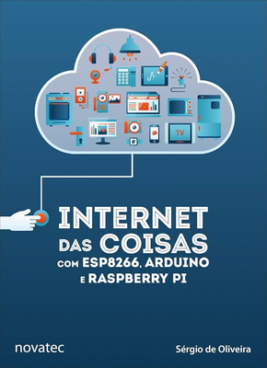
CONCEPTUAL FOUNDATIONS
Figure 3 - IoT book
The Internet of Things goes beyond the residential environment, as, with the power to collect and process data from interconnected environments and networks, it transforms our perception of the world around us, bringing diverse impacts in areas of logistics, traffic, and security. (OLIVEIRA, 2021).
Source: Amazon.com.br, 2025
Notes:
Também, incorporamos conceitos de IoT, o que nos ajudou a estruturar um dispositivo focado em aumentar a segurança de motoristas e terceiros.
-----------------------------------
We also incorporated IoT concepts, which helped us structure a device focused on increasing the safety of drivers and third parties.

Slide 11
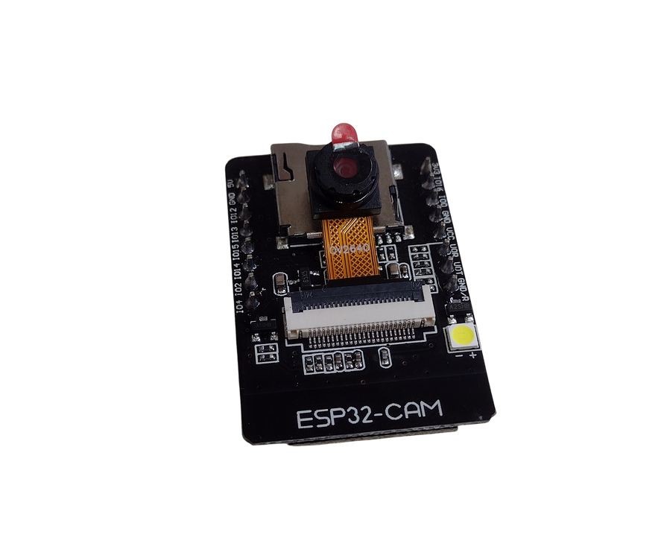
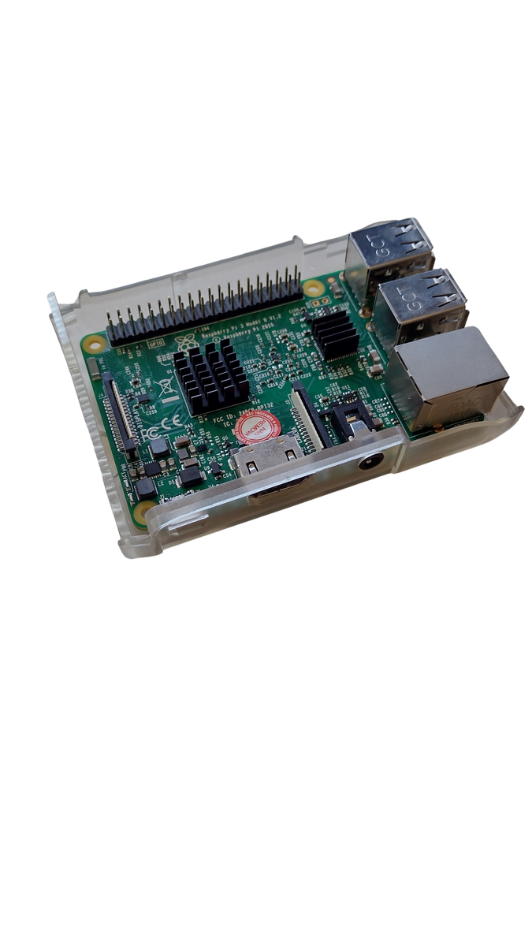


TECHNOLOGIES AND TOOLS
Figure 6 - ESP32-CAM
Figure 7 - Raspberry Pi
Figure 8 - Logo Python
Figure 9 - Logo C ++
Source: Own authorship, 2025
Source: Own authorship, 2025
Source: Python.org, 2025
Source: Microsoft Community, 2025
Notes:
In the SafeView project, we used ESP-CAM and Raspberry Pi as the main hardware for image capturing and processing. Python and C++ were applied for programming and system integration.

Slide 12
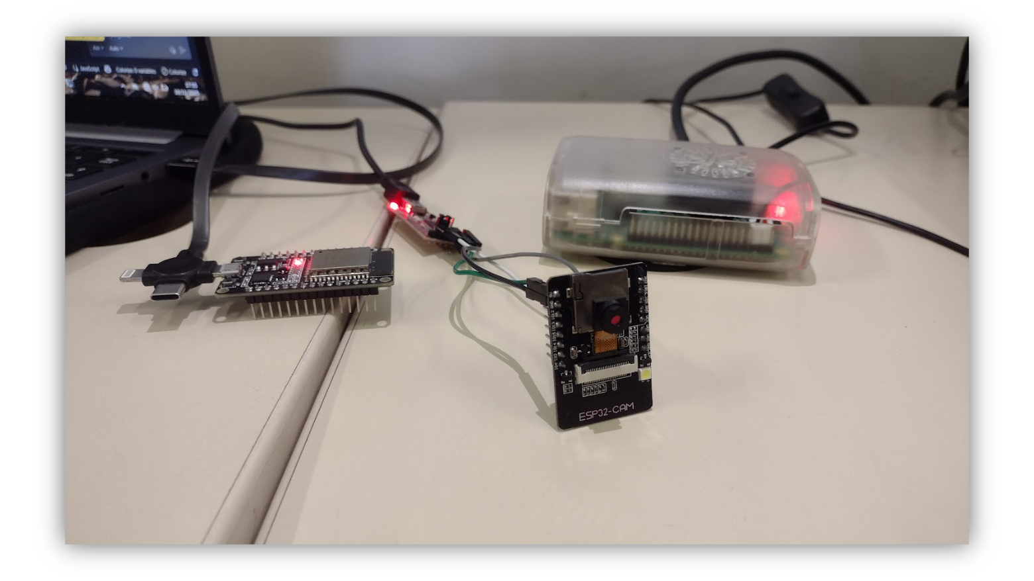
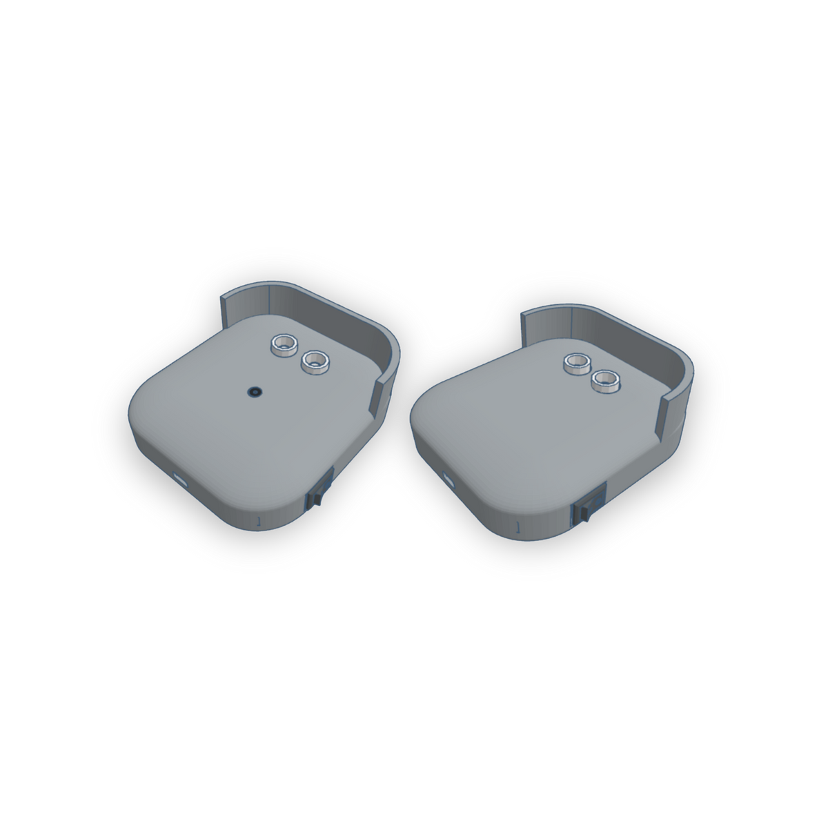
PROTOTYPE DEVICES

Slide 13





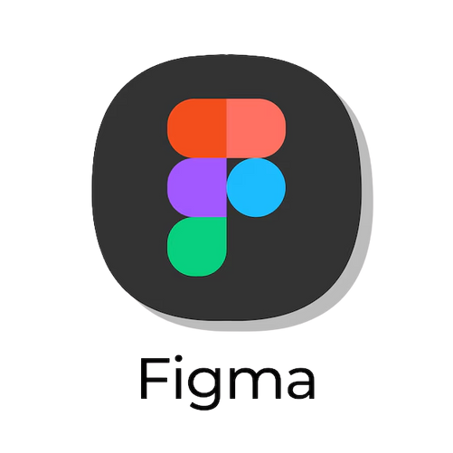
TECHNOLOGIES AND TOOLS
Figure 10 - Logo React Native
Figure 11 - Logo CSS
Figure 12 - Logo Firebase
Source: React Native, 2025.
Source: Ultimate Courses, 2025.
Source: Firebase, 2025.
Figure 13 - Logo Figma
Figure 14 - Logo UML
Source: Figma, 2025.
Source: Orbus Software, 2025.
Notes:
The mobile app was built with React Native and CSS, while Firebase (Cloud Firestore) ensured data storage and security. For design, we used Figma, and system modeling was done with UML, organizing processes and functionalities.

Slide 14

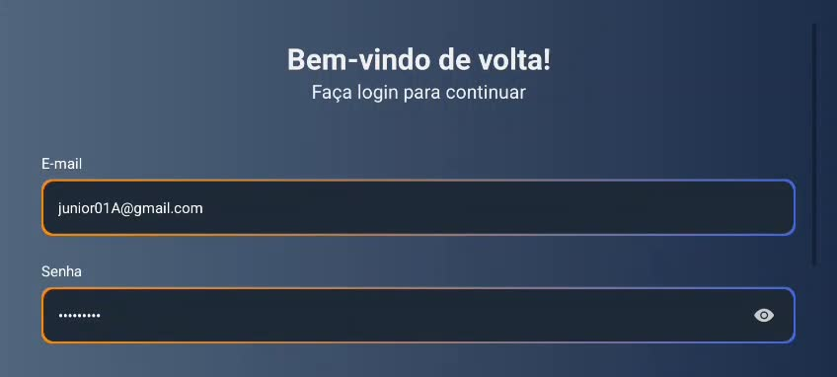

SAFEVIEW APP
Notes:
Starting with a quick look at the app, we begin by logging in. After that, we’re taken to the monitoring screen, where we can see the data from the devices. Next, we go to the profile screen, where the previously registered information is displayed.
ANTIGA--
Aqui vemos como o motorista irá interagir com o app.
O aplicativo recebe os dados do protótipo, organiza e apresenta dessa forma ao motorista.
-------------------------------------
Here we see how the driver will interact with the app.
The app receives the data from the prototype, organizes it, and presents it to the driver.
* adicionar o vídeo do app

Slide 15


KEY CONSIDERATIONS
Truck drives are the backone of logistics
SafeView was created to support the drivers and offering a solution that meets their real needs.
Notes:
As our final considerations, we conclude that we did several surveys to understand user needs better and improve the app functionality, which has already been developed. Our team is currently dedicated to executing the finals tests to guarantee a more efficient and enjoyable user experience.
In short, SafeView was created to support the people who keep the logistics sector moving — the drivers. Our goal is to understand their needs and provide a good solution.”

Slide 16
REFERENCES
Relatório Anual de Acidentes (CET). Available at: <https://www.cetsp.com.br/media/1058619/2019.pdf>. Access in: 24 august, 2025.
midiamax. Ciclista estaria no ponto cego de caminhoneiro quando acidente aconteceu no Parati. Available at:https://midiamax.uol.com.br/policia/transito/2024/ciclista-estaria-no-ponto-cedo-de-caminhoneiro-quando-acidente-aconteceu-no-parati/. Access in: 23 may. 2025.
Fundamentos de Metodologia Científica - 8ª edição. Authors: Marina de Andrade Marconi; Eva Maria Lakatos.
Internet das Coisas com ESP8266, Arduino e Raspberry Pi - 2ª Edição. Author: Sérgio de Oliveira.
Introdução a Programação em Python - 3ª Edição. Author: Nilo Ney Coutinho Menezes.
PROGRAMAÇÃO EM C++: ALGORITMOS, ESTRUTURAS DE DADOS E OBJETOS. Author: Luis Joyanes Aguilar.
React Native Desenvolvimento de aplicativos mobile com React. Authors: Diego Martins de Pinho; Bruna Escudelario.
Firebase (Google). Available at: <https://firebase.google.com/>. Access in: 24 august, 2025.
EBAC ONLINE. Figma. Available at: <https://ebaconline.com.br/>. Access in: 24 august, 2025.
UML 2 - Uma Abordagem Prática. Author: Gilleanes T. A. Guedes.

Slide 17
Thank you!!

